Slide 1
SHAP-Explainable image-to-Topology Regression
Charles Fanning

Slide 2
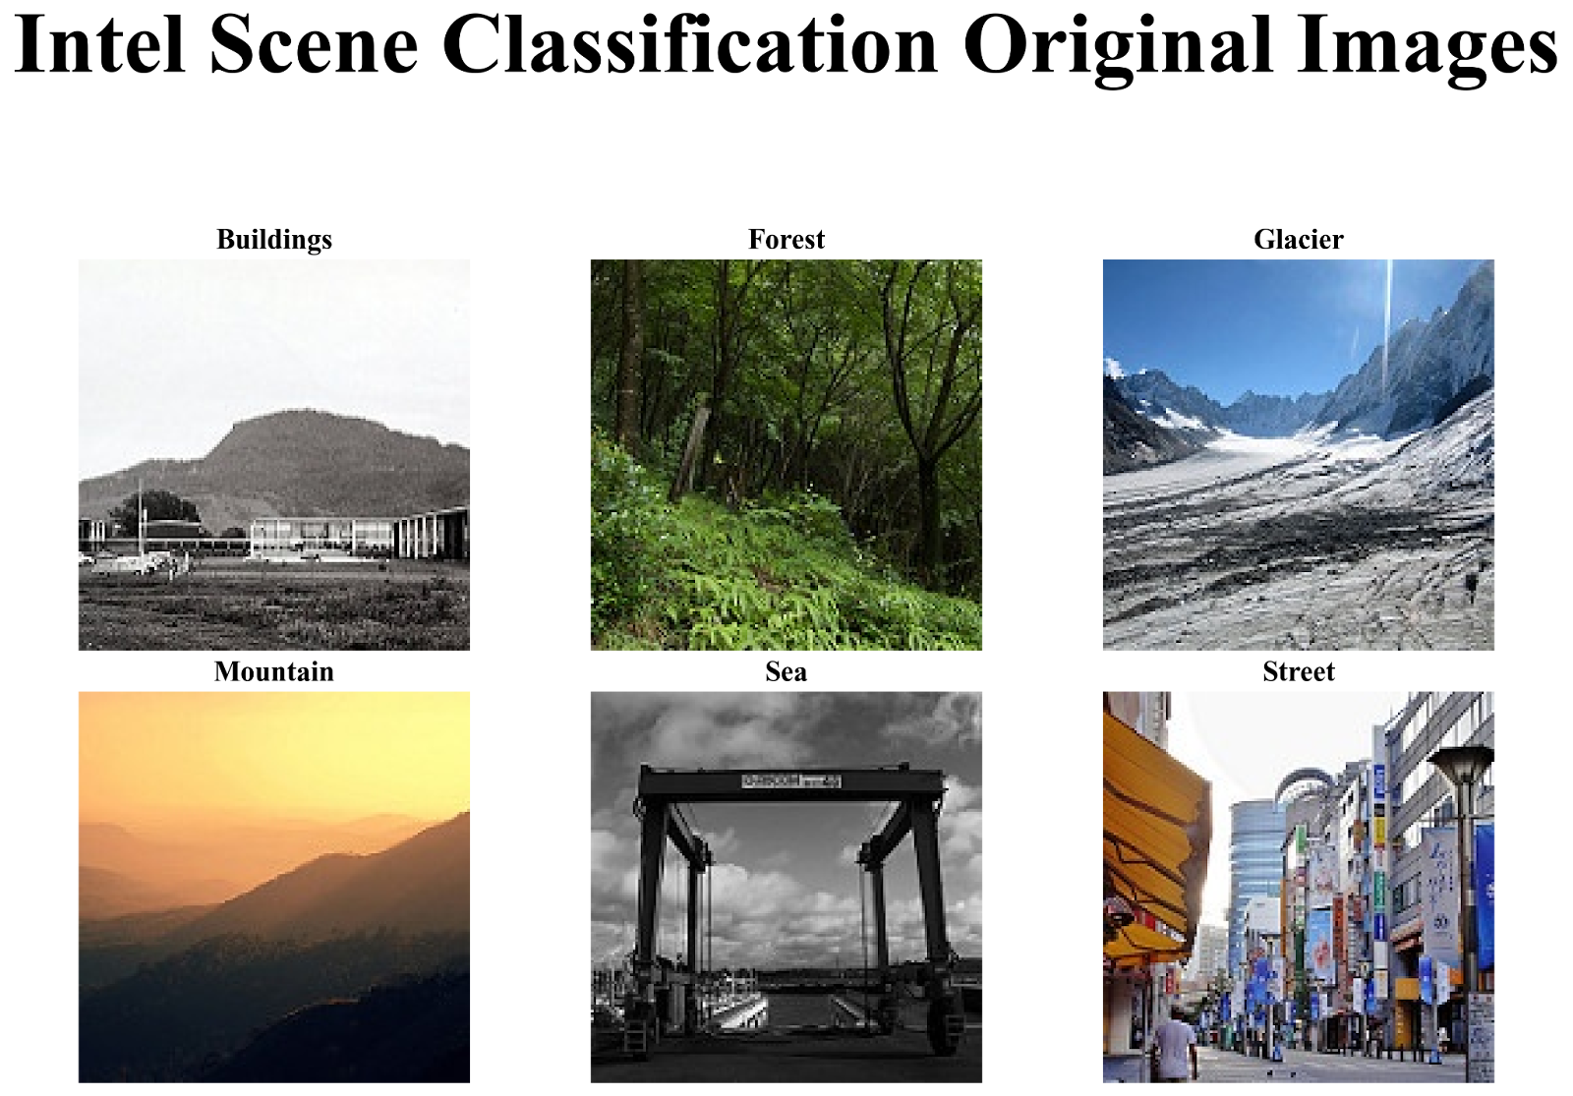
Intel Scene Classification Dataset
~25,000 color images of natural and urban scenes
Six categories: Buildings, Forest, Glacier, Mountain, Sea, Street
Most images are 150 × 150 pixels (minor outliers excluded)
Originally released for an Analytics Vidhya challenge by Intel
Commonly used for scene classification benchmarks
Pre-split into: • ~14,000 training • ~7,000 validation • ~3,000 test
Figure 1. Samples from the Intel Scene Classification dataset, each from one of the six scene categories: Buildings, Forest, Glacier, Mountain, Sea, and Street.

Slide 3
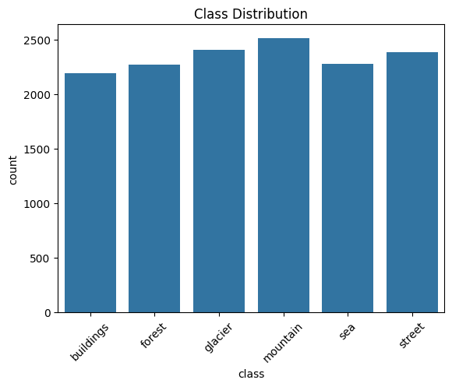
Class Distribution
The dataset is relatively balanced along the six categories, with counts ranging from approximately 2,000 to 2,500
Specifically, the highest representation was with the Mountain category, whereas Sea and Buildings had the least representation.
Figure 2. Count of observations from each one of the six scene categories: Buildings, Forest, Glacier, Mountain, Sea, and Street.

Slide 4
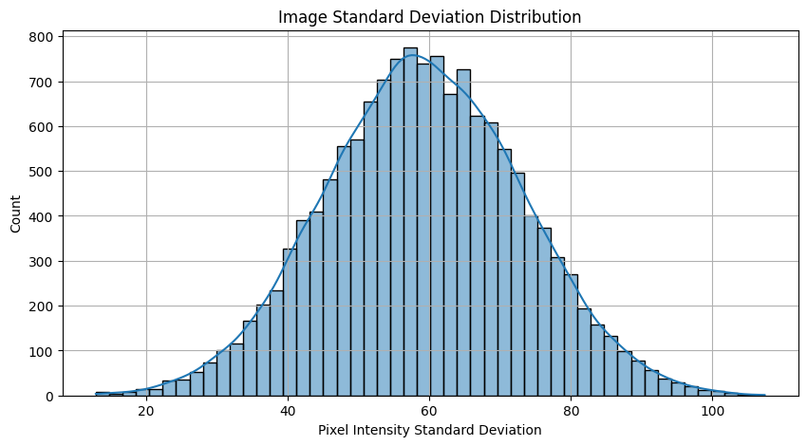
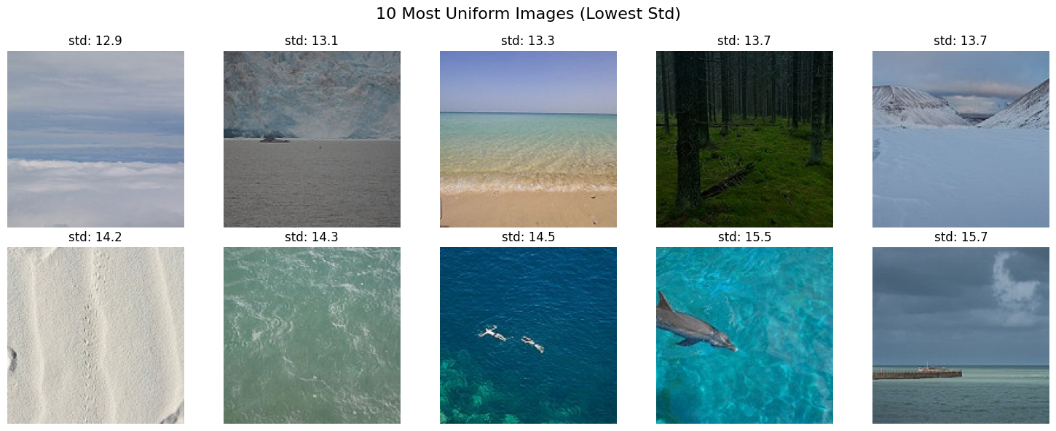
Data Cleaning
Figure 4. The ten images with the lowest standard deviations in pixel intensities. These still appear to be informative, so we keep them.
Figure 3. Histogram displaying frequency of standard deviations of pixel intensity values from each image in the training set of the Intel Scene Classification Dataset.

Slide 5
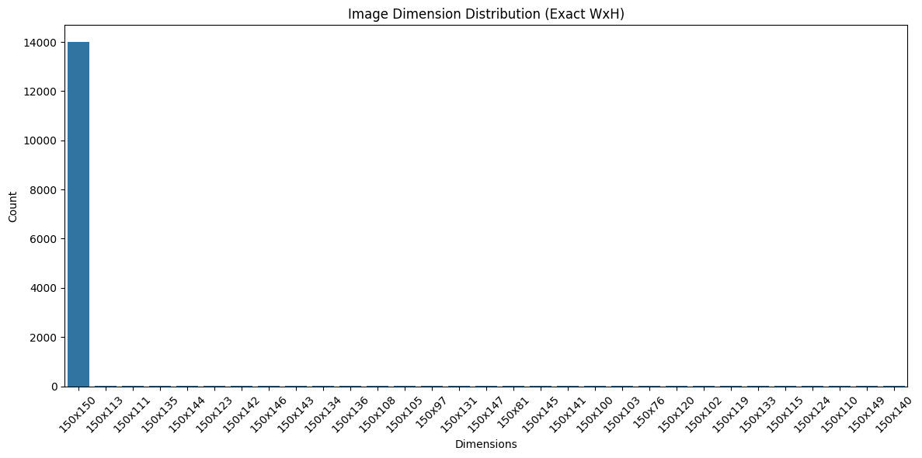
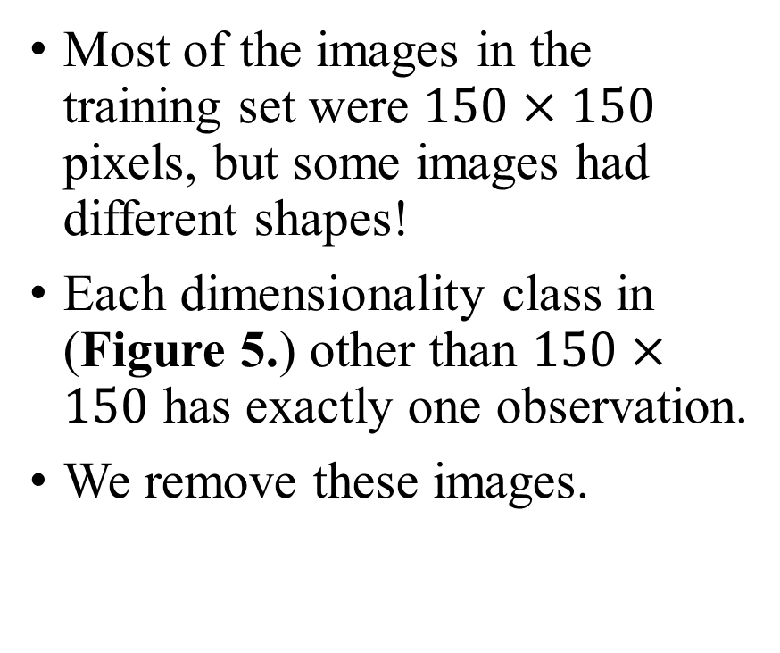
Data Cleaning
Most of the images in the training set were $150×150$ pixels, but some images had different shapes!
Each dimensionality class in (Figure 5.) other than $150×150$ has exactly one observation.
We remove these images.
Figure 5. Bar chart displaying the frequencies of image dimensions for each image in the training set of the Intel Scene Classification Dataset.

Slide 6
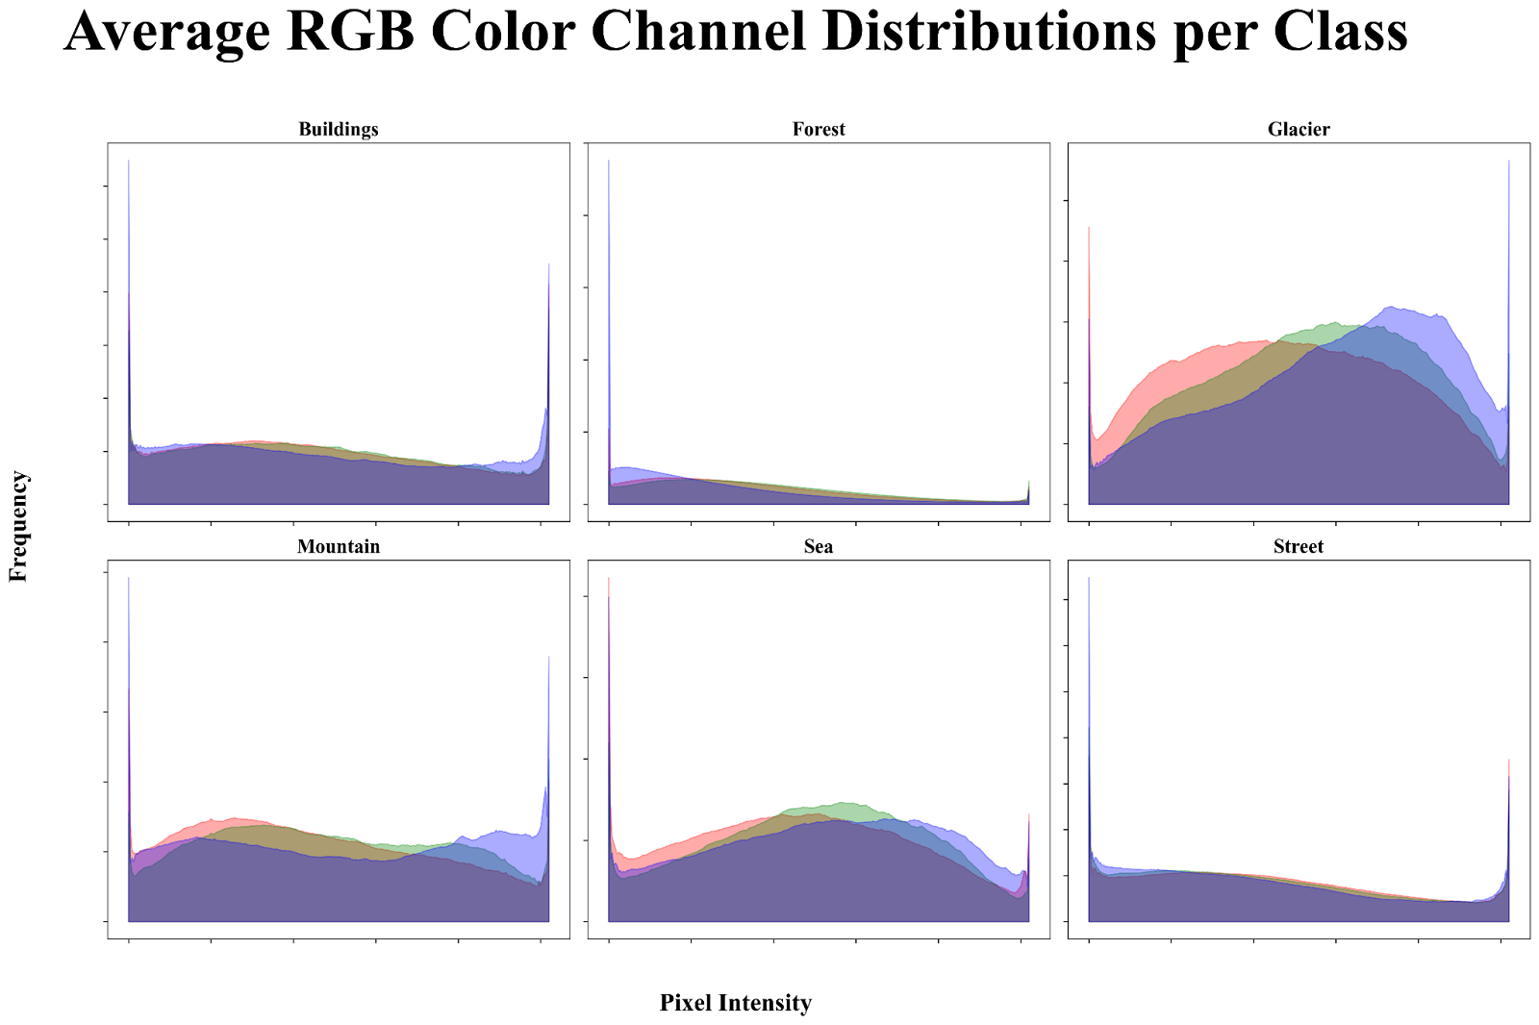
Exploratory Data Analysis
The distributions of color channels per class do not reveal any particularly noisy channels.
Figure 6. Average pixel-intensity histograms for the Red, Green, and Blue channels across the entire dataset.

Slide 7
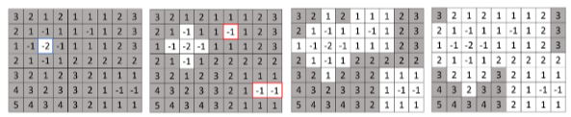
Persistent Homology Cubical Complexes
Homology is constructed by computing the number of topological features over the image.
This can be the number of connected components (1-dimensional topological features, holes (2-dimensional topological features), etc.
Persistent Homology is computed by tracking the cubical filtrations (Figure 7.) and keeping track of the changes in Homology across the filtration.
Figure 7. An example of how persistent homology is computed on an image based on its corresponding intensity values. Image Source: Kaji, S., Sudo, T., & Ahara, K. (2020). Cubical Ripser: Software for computing persistent homology of image and volume data. ArXiv, abs/2005.12692.

Slide 8
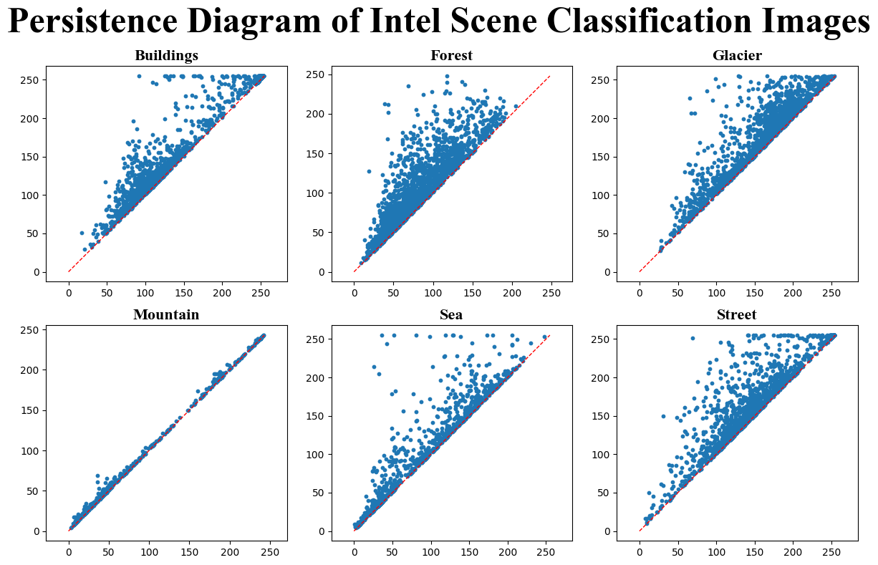
Persistent Homology Persistence Diagrams
We compute persistent homology for each image in the Intel Scene Classification Dataset and represent them as persistence diagrams.
However, we can not use these directly for deep learning because persistence intervals are multisets, not vectors.
Figure 8. Persistence diagrams for one representative image from each class in the Intel Scene Classification dataset. Each point represents the birth and death times of a topological feature, plotted on the horizontal and vertical axes, respectively.

Slide 9
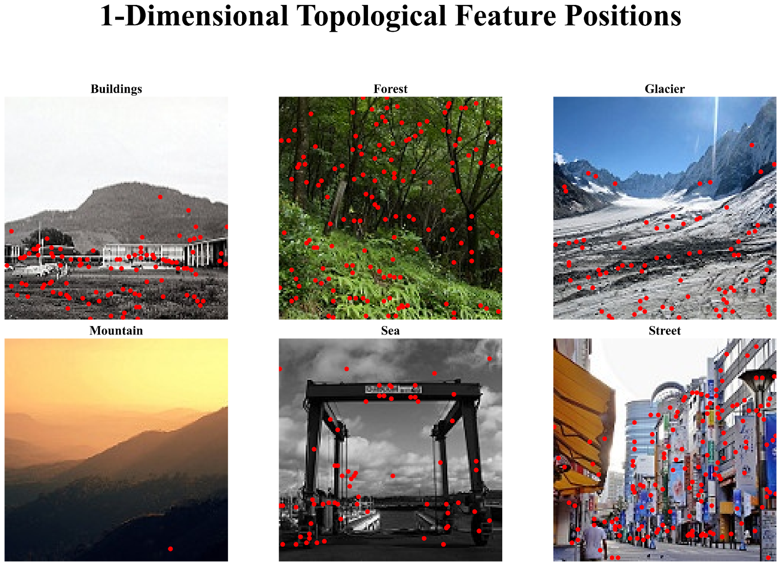
Reversing Persistent Homology
Using our persistence intervals, we can also determine which pixels are contributing to which persistence modules.
By thresholding above a certain lifetime value in our persistence diagram, we can display only the most import persistent points in our representation.
Figure 9. Topological hole locations from persistent homology. Red dots mark pixels corresponding to 1-dimensional features (holes) with lifetimes above a threshold.

Slide 10
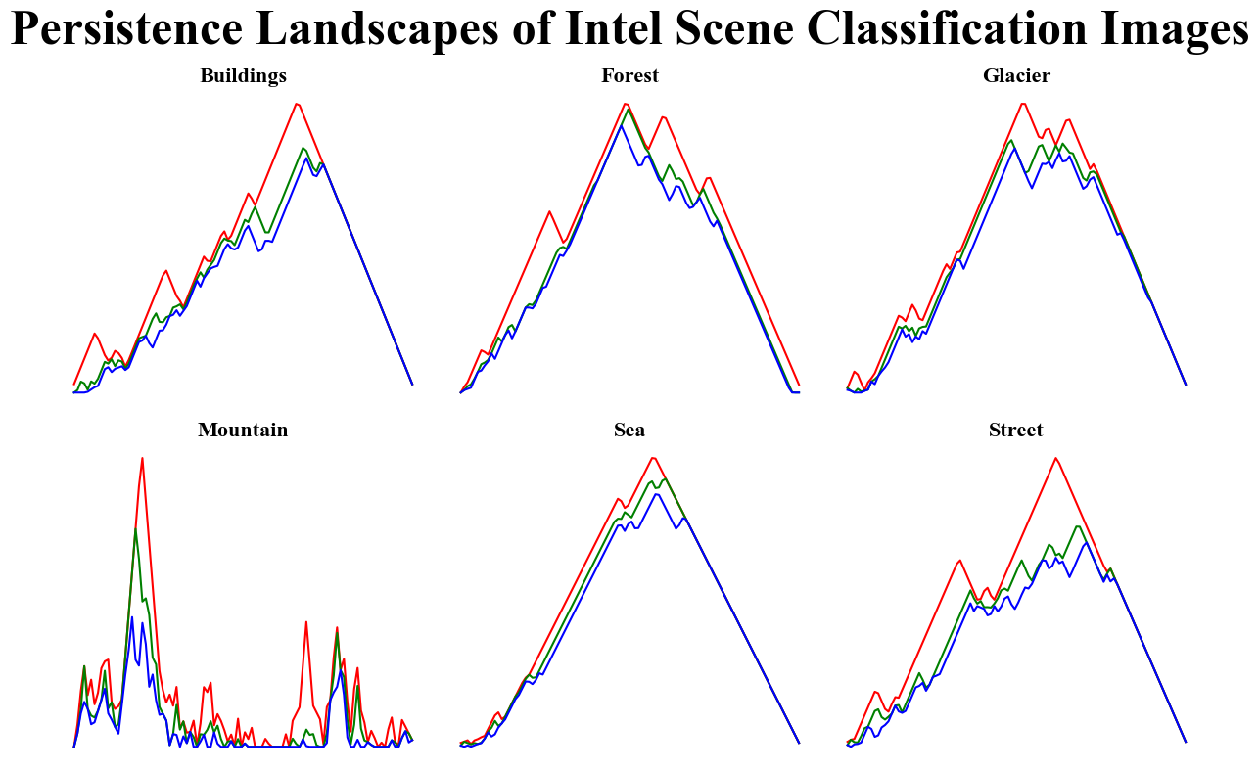
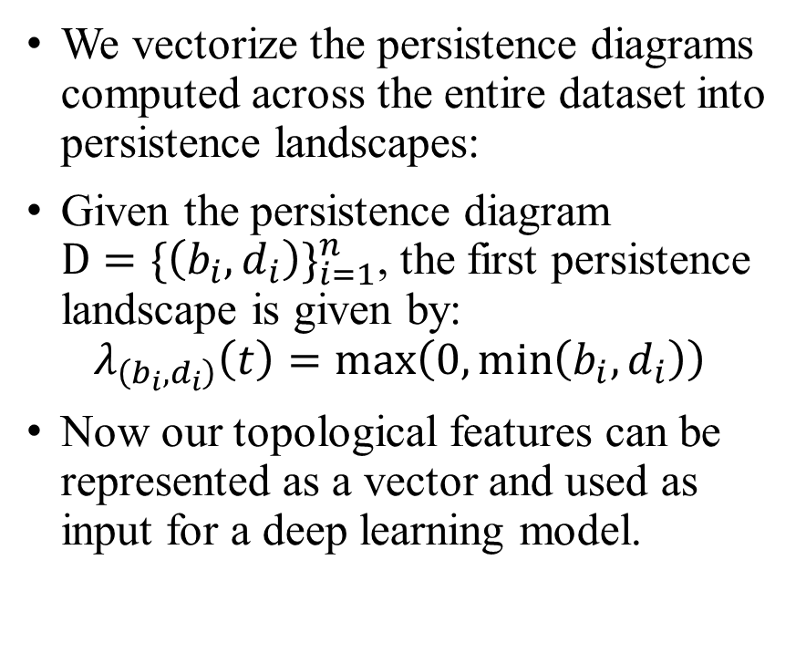
Persistence Landscapes
We vectorize the persistence diagrams computed across the entire dataset into persistence landscapes:
Given the persistence diagram ${D=\{\left(b_{i},d_{i}\right)\}}_{i=1}^{n}$, the first persistence landscape is given by:
$$λ_{\left(b_{i},d_{i}\right)}\left(t\right)=\max\left(0,\min\left(b_{i},d_{i}\right)\right)$$
Now our topological features can be represented as a vector and used as input for a deep learning model.
Figure 10. Persistence landscapes for representative images from each class in the Intel Scene Classification dataset. Each plot shows the first three landscape functions.

Slide 11
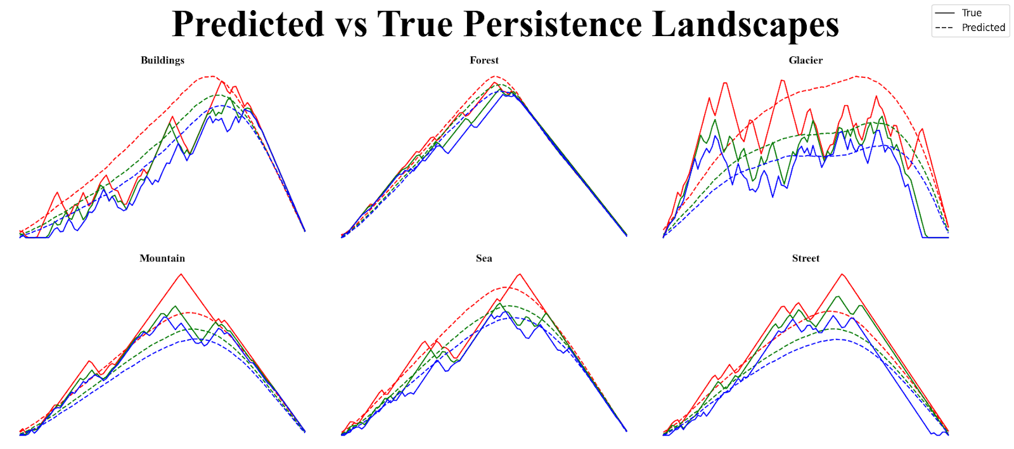
Image-to-Topology Regression
We train DenseNet-121 to take images from our training set as input and predict their vectorized persistence landscape.
https://www.semanticscholar.org/reader/5694e46284460a648fe29117cbc55f6c9be3fa3c
The predicted landscapes are much smoother than the true landscapes.
Figure 11. Predicted vs. true persistence landscapes for representative images from each class in the Intel Scene Classification dataset. Each plot shows the first three landscape functions (red, green, and blue, respectively), with the model’s predicted curves (dotted) compared to the ground truth (solid).

Slide 12
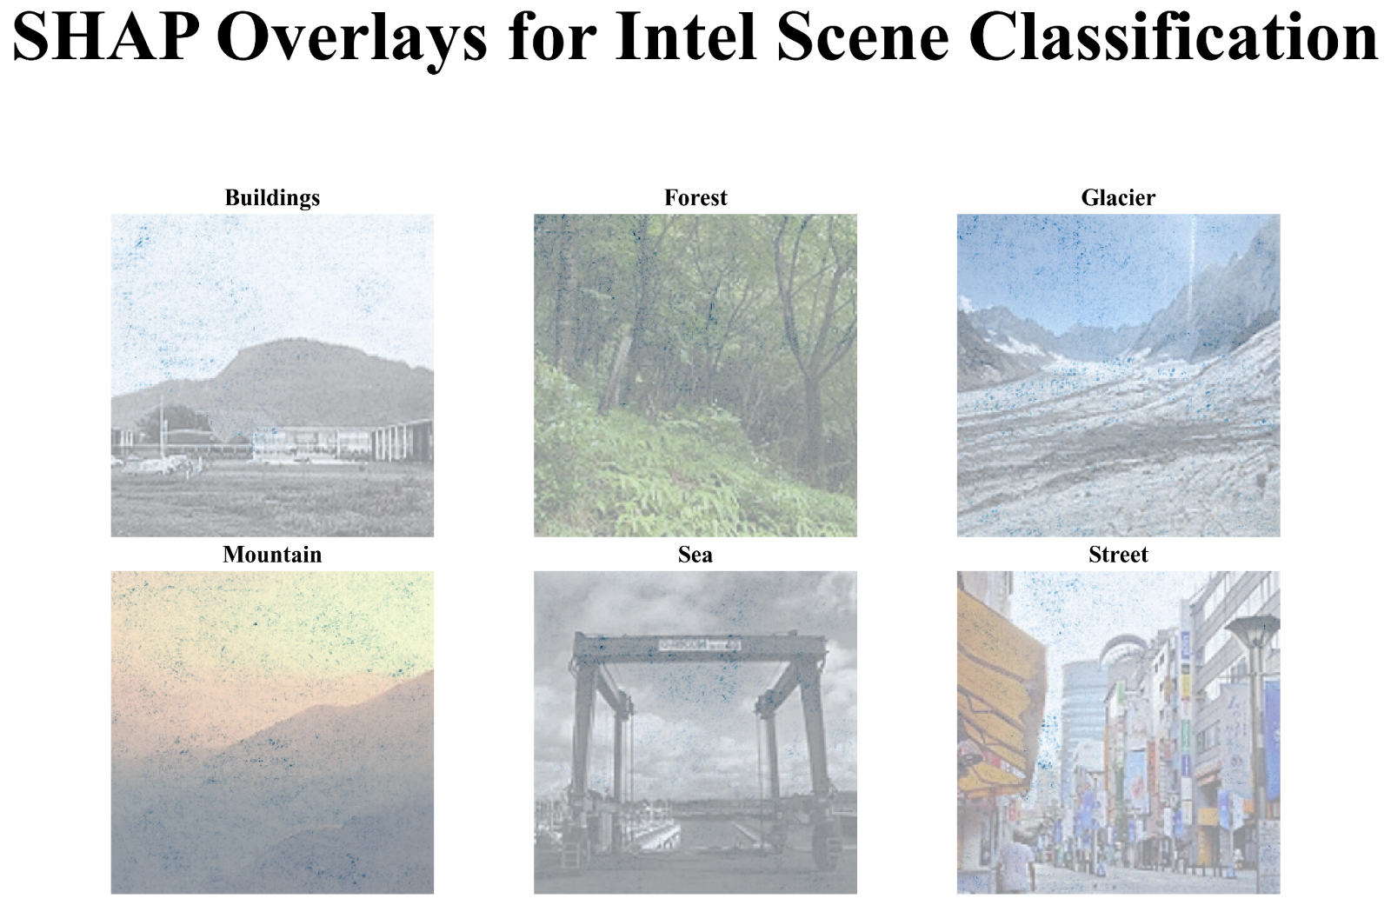
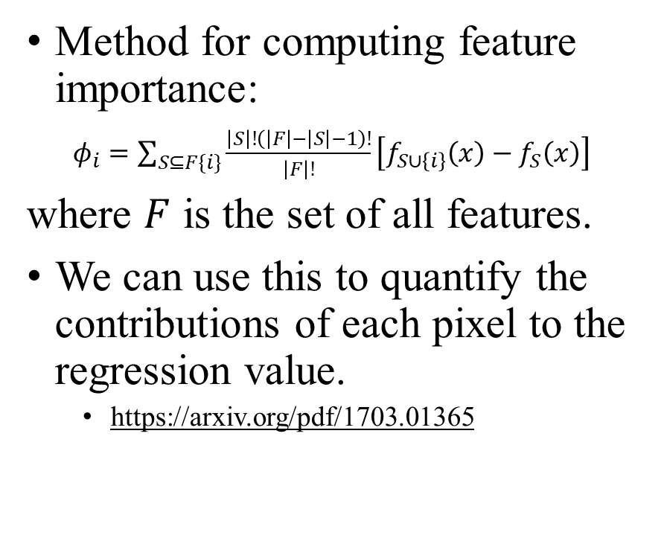
SHAP Values
Method for computing feature importance:
$φ_{i}=\sum_{S⊆F\{i\}}{\frac{\left|S\right|!\left(\left|F\right|−\left|S\right|−1\right)!}{\left|F\right|!}\left[f_{S∪\left\{i\right\}}\left(x\right)−f_{S}\left(x\right)\right]}$
where $F$ is the set of all features.
We can use this to quantify the contributions of each pixel to the regression value.
https://arxiv.org/pdf/1703.01365
Figure 12. SHAP explanations for representative samples from the Intel Scene Classification dataset. Each row displays five randomly selected images from one of the six scene categories—Buildings, Forest, Glacier, Mountain, Sea, and Street—with SHAP heatmaps overlaid to highlight the most influential pixel regions contributing to the predicted persistence landscape.

Slide 13
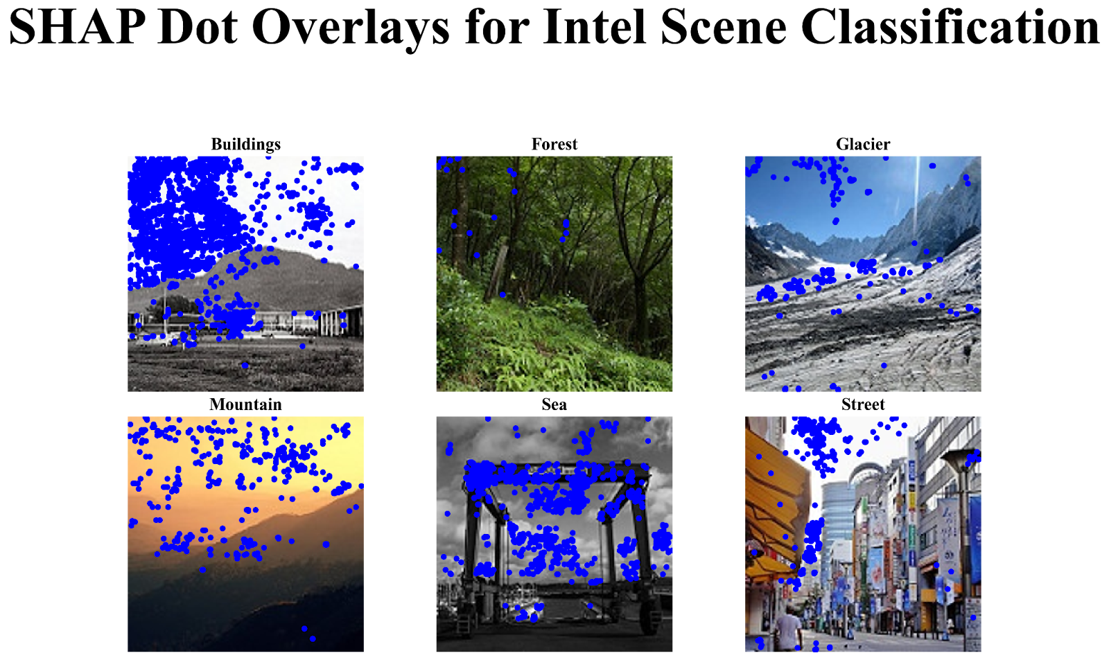
SHAP Values
Similarly to plain persistent homology, we can threshold over a certain value to display the most important pixels.
Figure 13. SHAP explanations for representative samples from the Intel Scene Classification dataset. SHAP heatmaps are thresholded and dots above a certain threshold value are overlaid to highlight the most influential pixel regions contributing to the predicted persistence landscape.

Slide 14
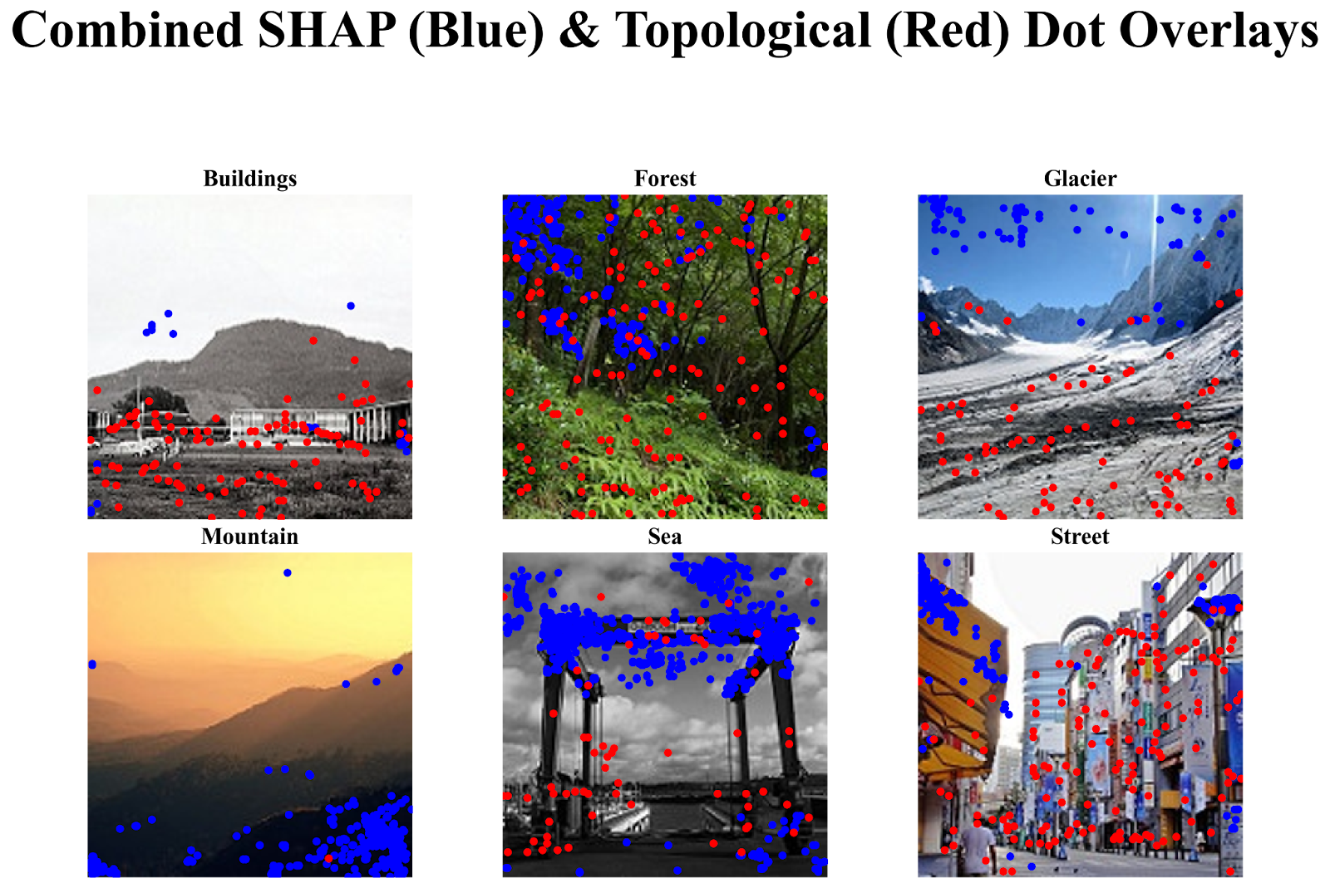
Persistence Values vs. SHAP Values
Visually, there is very little overlap between the Persistence Values and the SHAP Values.
Figure 14. Combined overlay of SHAP (blue) and topological (red) dot positions for each scene category. Pixels with SHAP values above a threshold are marked in blue. Pixels with persistence values above a certain threshold are marked in red.

Slide 15
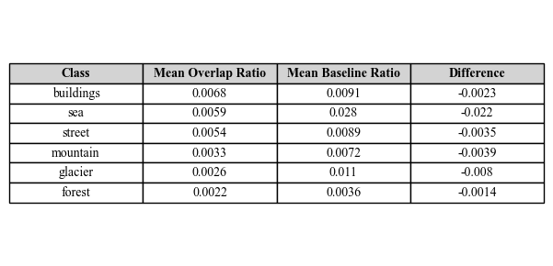
Is DenseNet Really Learning Persistence?
The overlap between the SHAP heatmap values and the baseline pixel values is greater than the overlap between the SHAP heatmap values and the most important pixels determined by Persistent Homology for each class!
Figure 15. Mean overlap ratio between SHAP explained heatmaps and 1-dimensional topological features across each class. A baseline is given between thresholded SHAP-identified pixels against the heatmap baseline.

Slide 16
Questions?

